Slide 1
Welcome to Biology
Mrs. Stephanie Hawkins

Slide 2
Contact Information
Email: hawkins.stephanie@cusd80.com
Phone: #480-224-2979
Office Hours: Monday-Thursday 2:15pm-3pm
(Designated Tutoring Day: Tuesday)

Slide 3
MORE FIGURING OUT, LESS LEARNING ABOUT
HOW IS THIS SCIENCE CLASS DIFFERENT?
STUDENTS NEED TO BECOME SELF-DIRECTED PROBLEM-SOLVERS!
What are students figuring out during each lesson?
What background knowledge do our students need to satisfy our State’s performance expectations?
How can we build coherence as we move through a unit?
How is teacher acting as facilitator and not simply a deliverer of information?

Slide 4
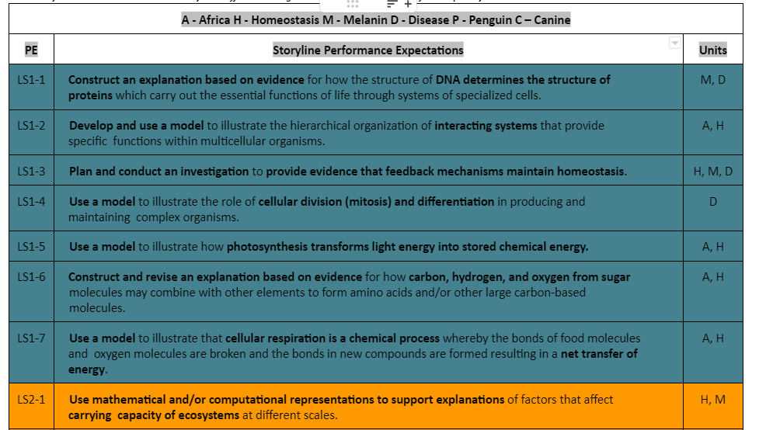
What will we cover in our storylines?

Slide 5
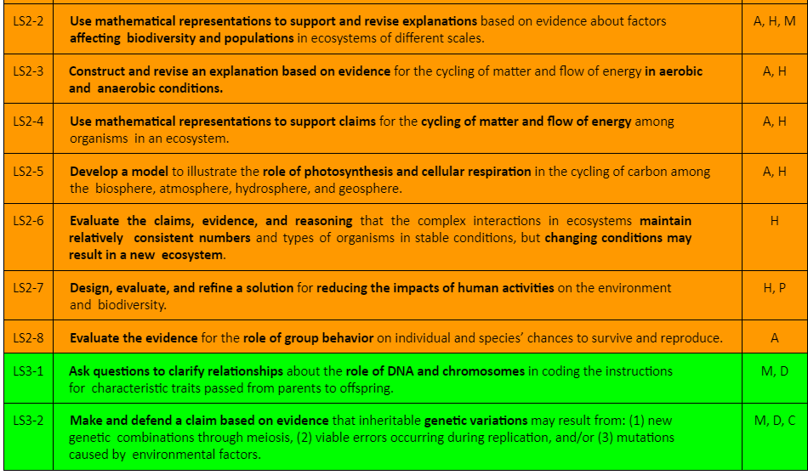
NGSS Standards Continued…

Slide 6
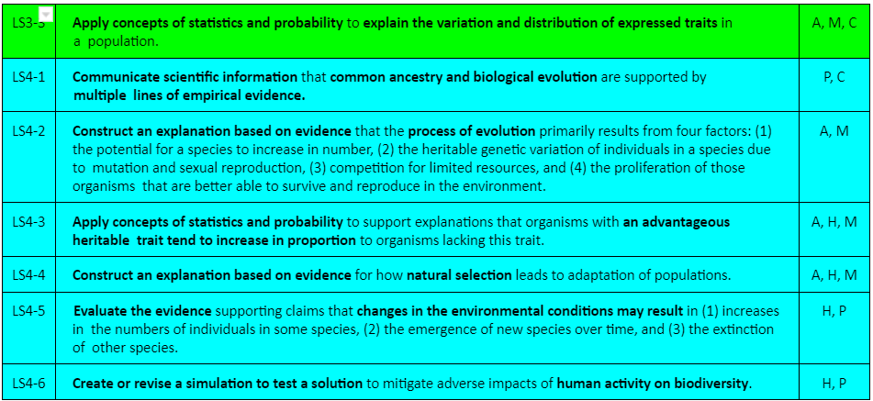
And a few more!

Slide 7
This is how my group will make storylining successful:
Show up with a working mentality!
Respect each other’s ideas and opinions.
Equal participation in group activities.
Be responsible for your work.
Work well together.
Positive attitude.
Work, to work harder!
Be productive.
Open communication.
Don't be afraid to be wrong, learn from your mistakes!
This is an example from 1st hour!

Slide 8
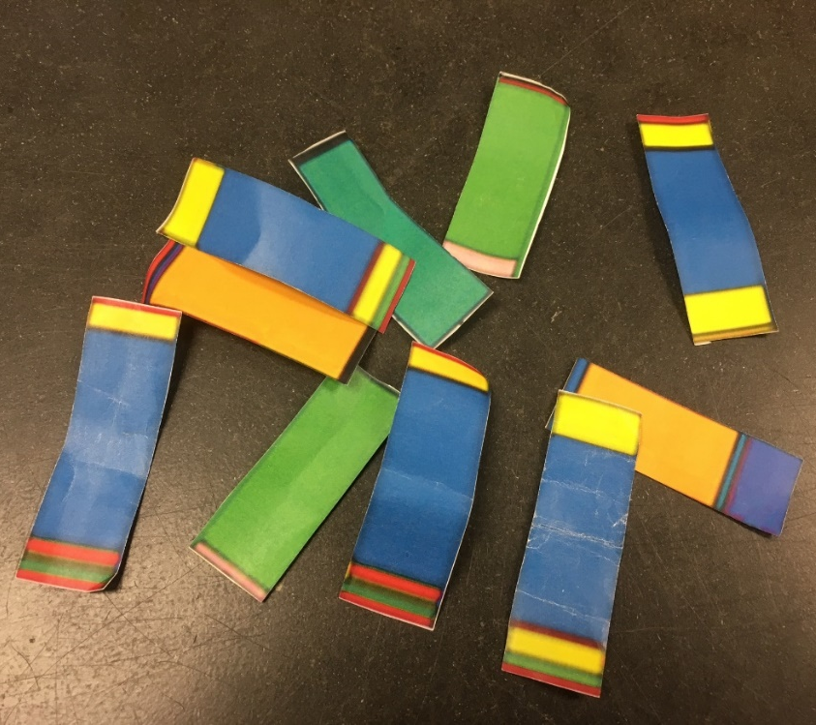
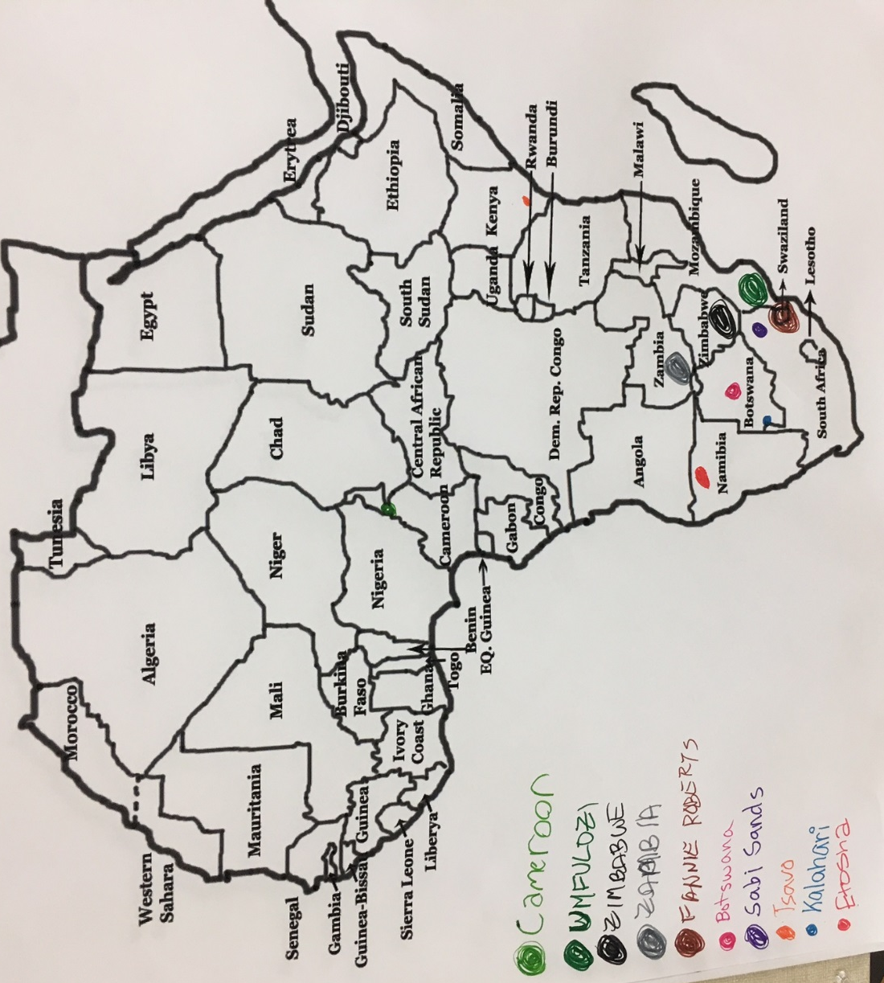
**Lots of group work and student driven activities this year!

Slide 9
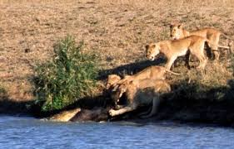
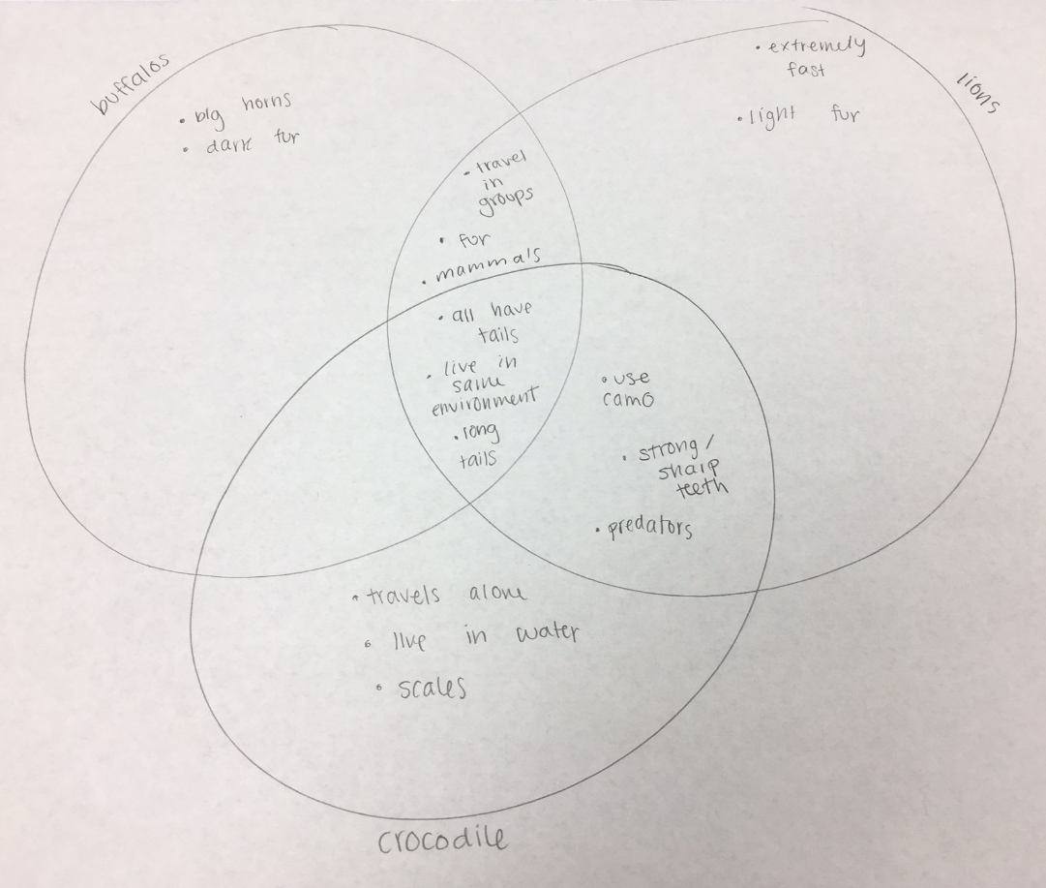
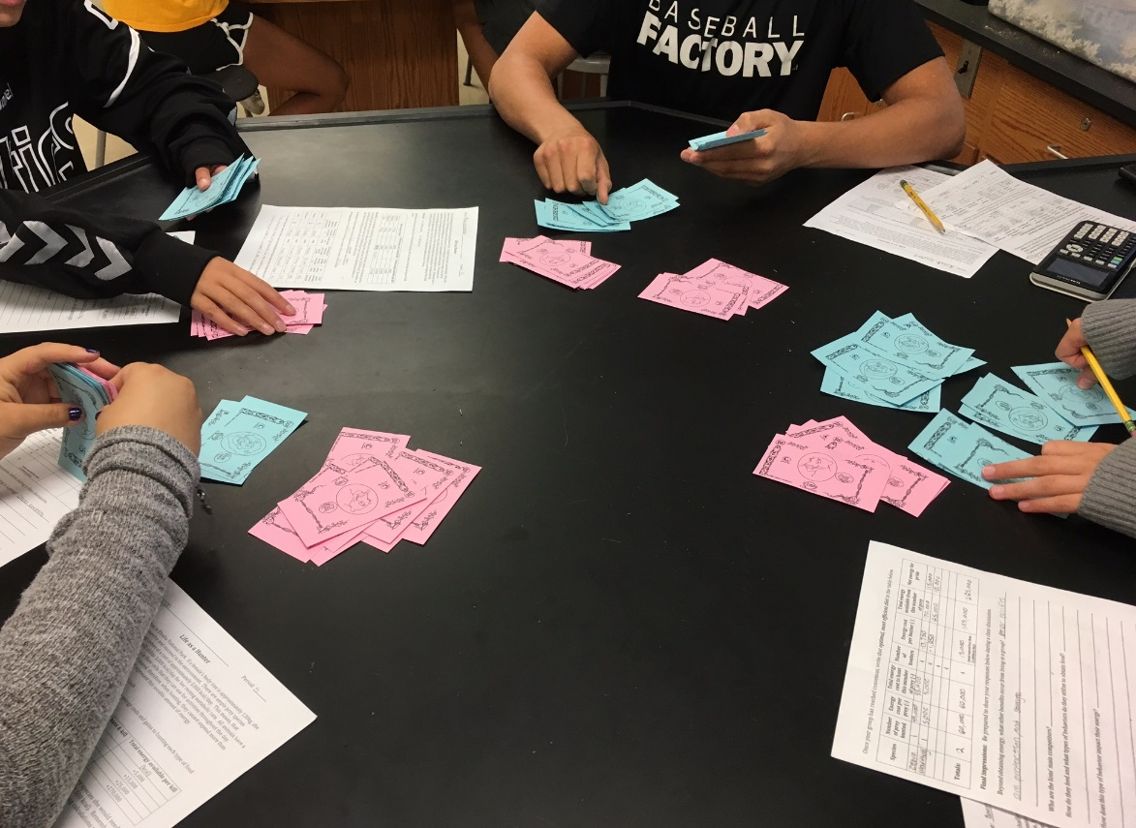

Slide 10
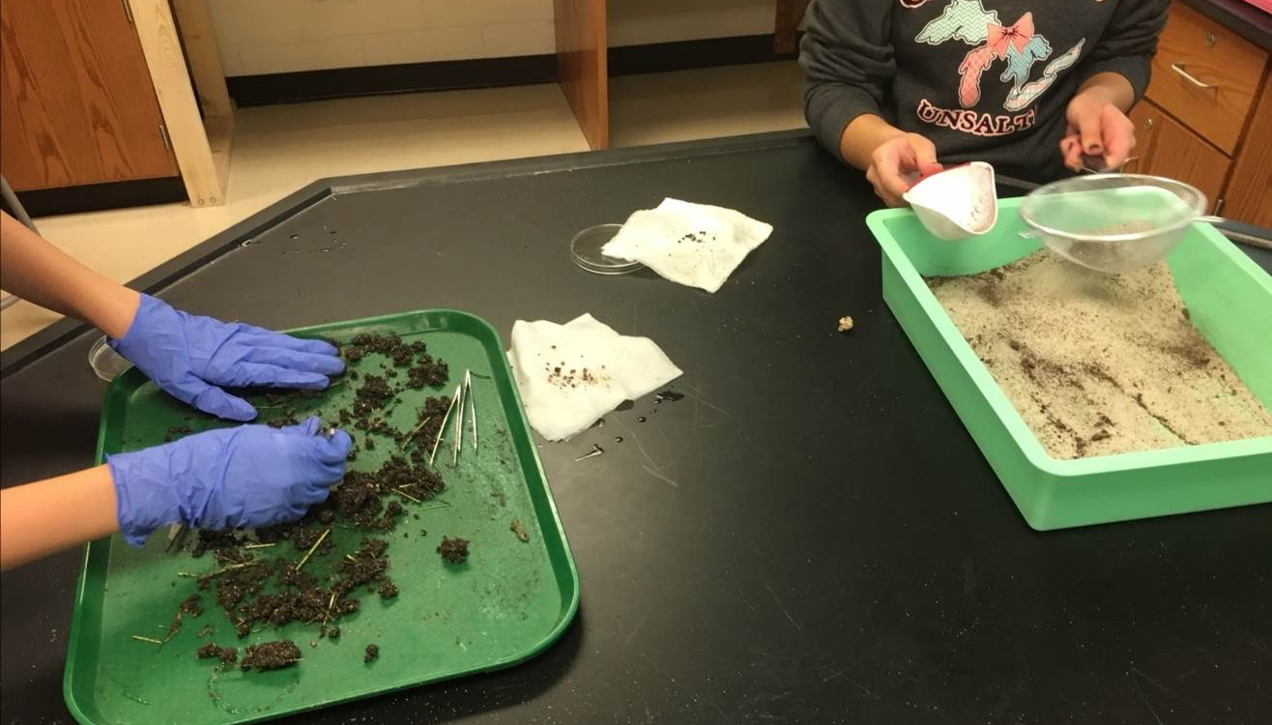
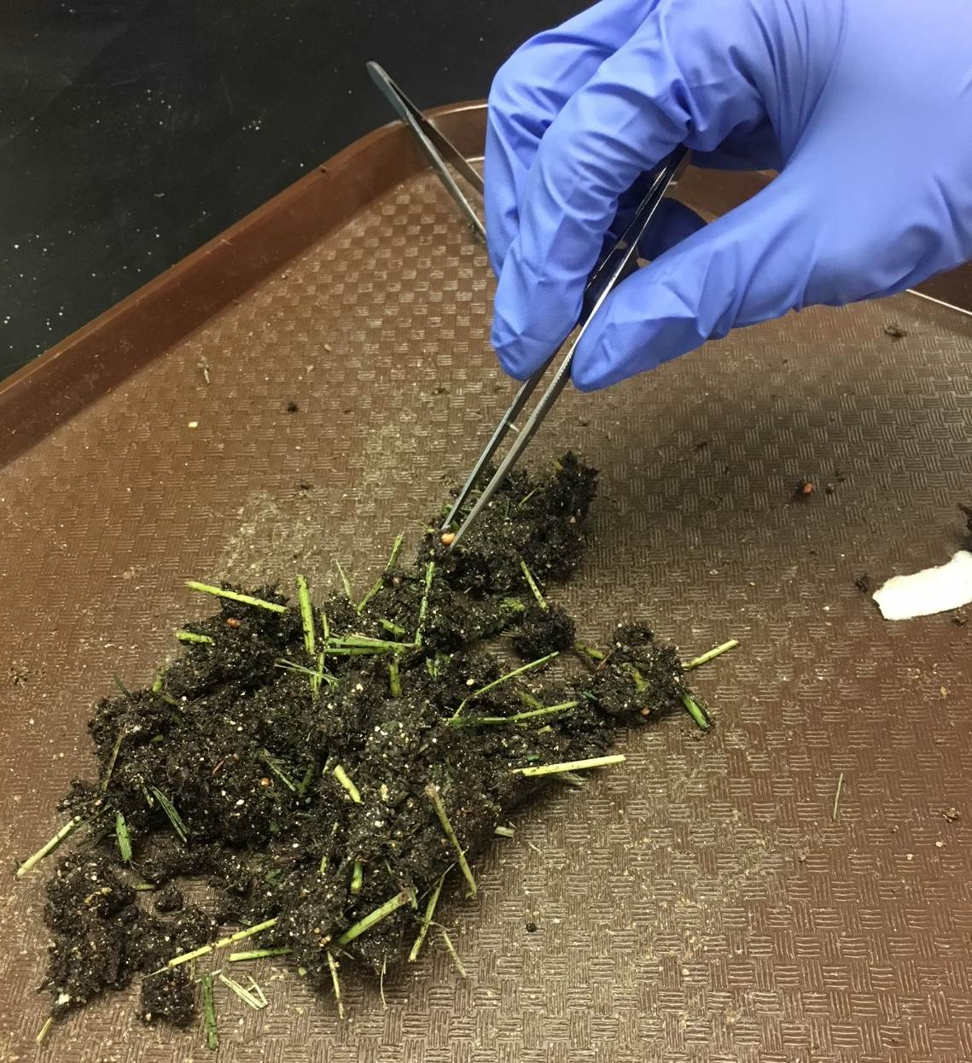

Slide 11
Late Work policy
-Late work is not accepted for credit. Please turn in your work on or before the due date. There are exceptions for excused absences or other extreme circumstances. Please discuss these situations with your teacher.
-students receive 3 Puma Passes each semester which will allow them to turn in an assignment 1 DAY after the due date for full credit.

Slide 12
Grades
Your grade will be based on the following:
Semester cumulative = 80% of semester grade
o 50% - Assessments
o 30% - Formal Labs / Group Activities
o 20% - Classwork / Participation/ Homework
Final exam = 20% of semester grade
Your grade will be determined by the number of points earned in the class. Please keep track of your grade using Infinite Campus.

Slide 13
Tardies and Absences
YES!
4 Tardies = Referral
15 or more absences= Seat time must be made up or lose that credit. 😟
-Not cool, so come to school!
Do they even matter???

Slide 14
Thank you!!

